Slide 1
Preliminary baseline sample size estimates
Final sample size target for biopsy will be informed by the results of the WAYFIND study
Biopsy – Fibrosis improvement without worsening of NASH
Outcomes – Composite Liver Events and Mortality
Range based on placebo rate 12-16%, dropout rate 10-20%
Sample Size:
488
606
654
Randomized 3:2, 90% power to detect 15% treatment effect at 2-sided alpha of 0.01, placebo rate 16%, dropout rate 15%, NRI imputation of missing data
Sample Size:
1870 (+1264 following biopsy)
Randomized 3:2, 80% power to detect HR 0.7 at 2-sided alpha of 0.05, enrollment of 800/yr, 15% dropout rate at 2 yrs, 5 yr FU, exponentially distributed time-to-event and time-to-dropout. 2-Yr EFS 0.93 for placebo

Slide 2
Standard NASH AA Trial Design
Key Features
Leverage strong WAYFIND result to accelerate full study recruitment
Biopsy subjects can contribute to outcomes data
Strongest support to accelerated approval NDA package with clinical outcomes study “well underway,” largest set of accrued clinical outcomes and safety for descriptive analysis
Study would close if biopsy result fails
Key Trade-Offs
Enrollment of outcomes patients starting 18 months ahead of biopsy readout is spend at risk
Sample sizes would be impacted if DRC/PC wanted to complete study following failed biopsy interim analysis
For option of varices endpoint, incorporating varices screening to broaden clinical composite would likely slow recruitment

Slide 3
Gated Enrollment Variant Design
Key Features
Enrollment pause delays spend on full outcomes recruitment until after biopsy result de-risks program
Biopsy subjects can contribute to outcomes data
Maintains operational efficiency of single study
Key Trade-Offs
Study likely considered “well underway” at time of NDA but not fully recruited, less data on outcomes
Enrollment pause risks unintended differences in patient cohorts
Recruitment may be slow if field doesn’t view WAYFIND as sufficiently supportive
For option of varices endpoint, incorporating varices screening to broaden clinical composite would likely slow recruitment

Slide 4
Separate P3 Biopsy Study and Outcomes Trial
Reasons considered
More flexible to include varices screening as part of clinical outcomes composite without impacting biopsy recruitment
More flexible to enrich outcomes study for later stage disease without early disease biopsy cohort “dilution”
Could follow biopsy subjects till outcomes and incorporate statistical borrowing methods to reduce sample size of outcomes study
Reasons not favored
Two separate studies caries greater operational cost
Biopsy subjects not monitored/followed for outcomes represents lost opportunity
Risk to AA approval that outcomes study may not be considered “well underway” and minimal descriptive data on outcomes
Statistical borrowing requires more complex assumptions and FDA alignment

Slide 5
Discussion of Key P3 Study Components
How we are thinking about other important elements of study design

Slide 6
Cumulative incidence of decompensation events* or liver transplantation over follow-up years among patients with compensated NASH cirrhosis accessing usual clinical care, identified in claims-based databases, MarketScan, HealthVerity, Optum and IQVIA PharMetrics, with published literatures
*ISB cohort preliminary analysis (20% of target cohort, n=195): ~17% at 3Y, ~20% at 5Y
*Decompensation events: hepatic encephalopathy, variceal hemorrhage, ascites, jaundice

Slide 7

Outcomes event rate can be tuned with NITs
Common measures of disease severity can balance biologic plausibility of treatment benefit and accrual rate of outcomes to construct feasible trial with high PTS
WAYFIND has ~1%/year event rate in 1st year
Selonsertib had ~2-3%/year event rate in 1st year
Simtuzumab had ~12%/year event rate in 1st year
Baseline Platelet | # PE | % PE | # CE | % CE
< 100k | 7/126 | 5.6% | 33 / 150 | 22.0%
100-125k | 10/166 | 6.0% | 14 / 193 | 7.3%
>125k | 109/707 | 15.4% | 24 / 787 | 3.0%
Disease Severity $∝$ Event Rate
Likelihood for Event
PE = fibrosis improvement without worsening of NASH
CE = clinical event
WAYFIND
Selonsertib
Simtuzumab
PBO EFS at 2 Yrs | Trial Size
0.84 | 927
0.87 | 1105
0.9 | 1383
0.93 | 1870
0.95 | 2477
Cirrhosis:
Early
Advanced
Decompensated
Platelets:
>125k
>100k
Steatosis:
Grade > 0
Grade = 0
Base Case:
ELF:
~20% > 11.3
Notes:
Voiceover: Option to Broaden/shift disease severity from WAYFIND population towards more advanced baseline

Slide 8
Composite clinical liver events can be expanded to enhanced event rate accrual
Could consider expanding the composite of clinical liver events to accelerate outcomes timelines without modulating baseline disease severity
FDA: Components of composite outcome must be of similar clinical importance. Risk treatment effect could largely be seen in only lowest severity component complicating interpretation of treatment benefit (Guidance on Multiple Endpoints)
Conventional Clinical Liver Events | Additional Clinical Events
Complication of ascites (SBP, refractory ascites, hepato-pleural effusion) | New esophageal varices
Variceal hemorrhage | Progression of varices
Hepatic encephalopathy | Development of CSPH/Worsening of HVPG
MELD >= 15 | Hepatocellular carcinoma
Liver transplantation | MACE-3
Death from any cause | Renal composite events
Notes:
Voiceover: Incorporate varices into endpoint analysis as part of composite or hierarchical endpoint

Slide 9
Hierarchical composite endpoint may balance key concerns with composite endpoint
HCE including varices can improve event rate accrual without necessarily overweighting varices, though significant uncertainty remains
Benefits
Allows for expanded definition of clinical outcomes with ordinal ranking
Substantially reduces sample size of outcomes trial (possibly up to 50% less)
Variable stopping criteria (2-4 require drug d/c, 1 does not) could balance against accumulation of varices events alone
Risks
Untested approach in NASH and Cirrhosis
EMA: Clear position against varices in composite
Highly likely that varices would be majority of registered events
Intermediate events could increase drop out due to perception of ineffective therapy
Decreased power to detect conventional composite endpoint if sample size selected for composite with varices
0
No Worsening of Cirrhosis
1
New or Worsening Varices
2
Ascites
3
Hepatic Encephalopathy
Could combine into one grouping
4
Variceal Bleeding
5
Death
Inclusion of additional relevant conditions increases complexity, although they are less common:
jaundice, hepatic hydrothorax, spontaneous bacterial peritonitis, hepatorenal syndrome, hepatopulmonary syndrome, portopulmonary hypertension

Slide 10
Appendices

Slide 11
Regulatory Considerations

Slide 12
Regulatory guidance: single pivotal study to support approval^{1,2}
Regulatory guidance documents from US/EU have no formal requirement for two pivotal studies
Two Phase 3 confirmatory studies provide:
Replication of scientific results
Sufficient number of sites/subjects; minimal chance of bias
Assurance of validity of results for NME or new therapeutic area
A single study to support approval:
Needs to provide very persuasive evidence
Statistically very persuasive finding
Must be internally consistent across study subsets
Efficacious in multiple endpoints
Unethical to repeat the study
Outcome substantiated by supportive evidence of efficacy from related clinical studies
Phase 2 studies in same population, studies in other phases of the same disease, or evidence from studies in other populations

Slide 13
Accelerated approval & confirmatory trial requirements
US
FDA Omnibus Reform Act amends the AA framework at Section 506(c) of the FDCA thereby allowing FDA to require post-approval studies to be underway prior to approval or within a specified time period after the date of approval
Regeneron received CRL for AAs of its CD20xCD3 bispecific odronextamab in certain blood cancers because of progress on confirmatory trials
Confirmatory trial ‘underway’ will be evaluated on a case-by-case basis with no straightforward answer to the exact level of progress that the FDA wants to see at the time of AA
FDA will exert some flexibility in areas of unmet need but will look to level the playing field for all the sponsors with AA for the same disease
EU
Uncertainty around conversion of conditional marketing authorization to full marketing authorization with OCA failing to confirm the benefit in the outcomes study COBALT

Slide 14
WAYFIND Result Informs Staged/Gated P3 Risk

Slide 15
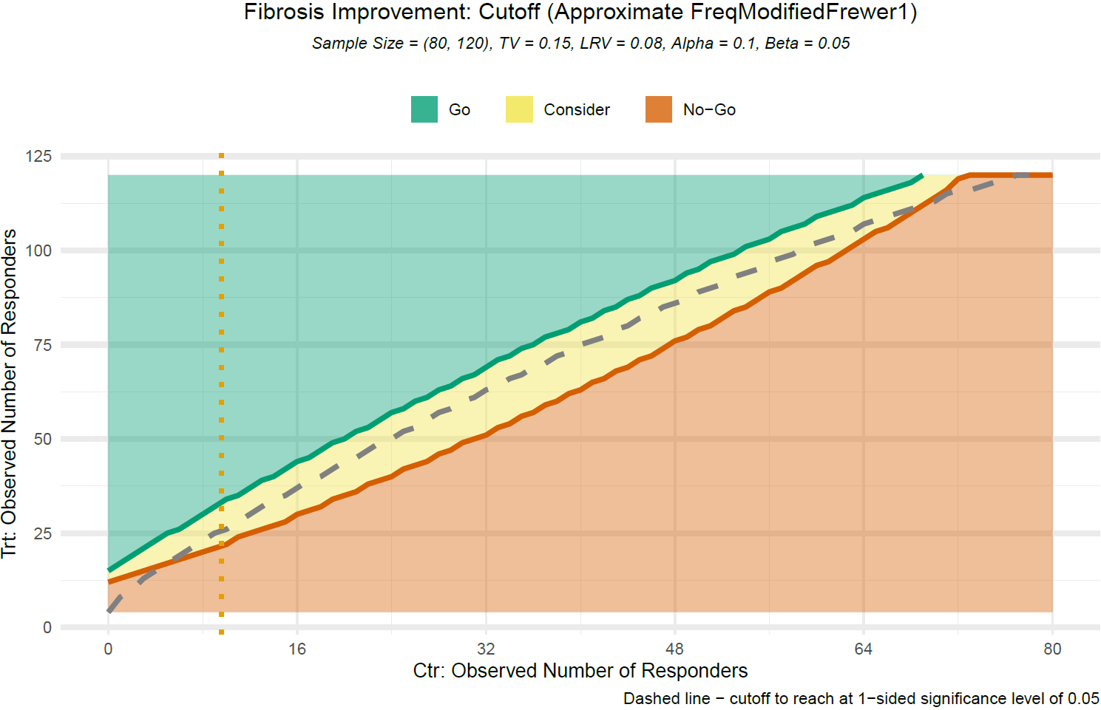
Strength of WAYFIND evidence gates P3 recruitment plans
Strength of evidence in WAYFIND could inform risk tolerance and spend cadence in Phase 3 design
Obs Resp in Placebo (N = 80) | Obs Treatment Effect vs PBO |  |  | Prob of Success (PoS)* of Ph3
Placebo Resp | No-Go (≤) | Go (≥) | 1-Sided P ≤ 0.05 (≥) | No-Go (≤) | Go (≥) | 1-Sided P ≤ 0.05 (≥)
8 ( 10.0%) | 6.7% | 15.0% | 9.2% | 54.1% | 92.4% | 68.8%
10 ( 12.5%) | 5.8% | 15.8% | 9.2% | 36.6% | 87.9% | 60.6%
12 ( 15.0%) | 5.8% | 15.8% | 10.0% | 39.2% | 85.8% | 62.0%
16 ( 20.0%) | 5.0% | 16.7% | 10.8% | 31.9% | 87.0% | 61.7%
20 ( 25.0%) | 4.2% | 16.7% | 11.7% | 26.5% | 84.8% | 66.3%
Go
Rapid full recruitment
Consider
Staged recruitment (delay to outcomes)
LRV = Δ8%, TV = Δ15%; false-go = 0.1, false-stop = 0.05; decisions are based on observed data
* PoS was computed using Bayesian method to estimate the likelihood of success of the Ph3 study using data observed from current Ph2, where Ph2 was with sample size of 120:80 and 20% dropout, and Ph3 assumes the following design: N = 606, 3:2 randomization, 15% dropout and 2-sided alpha = 0.01. Missing data were imputed with NRI method. Beta priors, i.e Beta(0.12, 0.88) and Beta(0.22, 0.78) for response rates in placebo and treatment, respectively, were considered.

Slide 16
Competitor Safety databases and Outcomes Study Status at NDA
Sponsor | Indication | Comparator Studies in NASH-enrollment numbers | Predicted Size of Safety Database at NDA (not including ph1 studies) | Numbers by Fibrosis Score | Likely Status of Outcomes Study
Galectin (belapectin, GR-MD-02) | F4 (clinical signs of portal hypertension) | NASH-CX ph2 (108 participants) NAVIGATE ph2b/3 (315 participants) (IA/adaptive design). | Molecule also being studied in fibrosis, atopic dermatitis, psoriasis, cancer immunotherapy | F4: 423 | NAVIGATE Stage 1 (Phase 2b) is fully enrolled. Patients will roll over into Stage 2 (Phase 3) of the trial. Therefore, if AA is submitted after Ph2b, the Phase 3 study is well underway.
Madrigal (resmetirom) | Approved for F2/F3 | 4 Phase 3 clinical trials: MAESTRO-NASH (F1-F3): 1,000 MAESTRO-NAFLD-1:1200 MAESTRO-NAFLD-OLE:700 MAESTRO-NASH-OUTCOMES (F4) 700: | ~3450 | F2/F3: 2900 F4: 700 | 2 Outcomes studies- 1st fully enrolled (MAESTRO-NASH) and the 2nd one (MAESTRO-NASH OUTCOMES in F4) was underway at the time of NDA approval under AA pathway
89Bio (Pegozafermin) | F2-F4 | ENLIVEN (F2/3) ph2b: 222 NASH: ENLIGHTEN-Cirrhosis:762 ENLIGHTEN (F2/3)-Fibrosis:1050 | ~2400* *Safety database will be inclusive of data from the ongoing SHTG Phase 3 program (anticipated 360 participants). | F2/3: 1272 F4:762 | ENLIGHTEN-Fibrosis will continue to follow patients for long-term clinical outcomes. This study will be fully enrolled and ongoing for Outcomes at the time of NDA-AA submission. ENLIGHTEN-Cirrhosis will follow patients for clinical outcomes. A subset of patients will be analyzed at interim analysis to support an NDA-AA. The outcomes study will be well underway
Akero (Efruxifermin) | F1-F4 | BALANCED (F1-F3) ph2a: 80 HARMONY (F2/3) ph2b: 128 Cohort D (F1-3): expansion cohort GLP-1: 31 SYMMETRY (F4) ph2b study in cirrhotic : 182 SYNCHRONY Histology (F2/3) ph3: 1000 SYNCHRONY Real-World (F1-F3) ph3: 700 SYNCHRONY Outcomes study ph3 (F4):tbd | >2000+ F4 outcomes study TBD | F1/F2/F3: >1900 F4:182:+outcomes study TBD | SYNCHRONY Histology will continue to follow patients for long-term clinical outcomes. This study will be fully enrolled and ongoing for Outcomes portion at the time of NDA submission SYNCHRONY Outcomes study planned to be kicked off in 1H2024.

Slide 17
WAYFIND Combination Mechanisms
GLP-1 RA
Semaglutide (SEMA)
Metabolic (weight loss, insulin sensitivity, glucose) & anti-inflammatory effects, CV risk reduction*^{1,2}
Metabolism
Lipotoxicity
Fibrogenesis
Hepatocyte
FIR
HSC
Adipocyte
β-oxidation
Profibrotic Genes
ACCi
Firsocostat (FIR)
Reduced DNL & enhanced β‐oxidation, inhibition of HSC activation
TAG
FIR
DNL
Inflammation
SEMA
Insulin
NEFA
Macrophage
Lipotoxicity
SEMA
FIR
FXR
Cilofexor (CILO)
Increased FGF19 secretion (suppressed bile acid synthesis, lipogenesis, and
gluconeogenesis)
Cytokines
Bile acids
SEMA
DIET
Intestine
FGFR4/β-klotho
FGF19
CILO
*CV risk reduction in patients with type 2 diabetes and high CV risk1
ACC, acetyl-CoA carboxylase; CV, cardiovascular; DNL, de novo lipogenesis; FGF19, fibroblast growth factor 19; FGFR4, FGF receptor 4; FXR, farnesoid X receptor; GLP-1, glucagon-like peptide-1; HSC, hepatic stellate cell; NASH, non-alcoholic steatohepatitis; NEFA, non-esterified fatty acids; TAG, triacylglycerol. 1. Marso SP, et al. N Engl J Med 2016;375:1834–44; 2. Rakipovski G, et al. JACC Basic Transl Sci 2018;3:844–57; 3. Marra F. J Hepatol 2018;68:280–95; 4. Newsome PN, et al. AASLD 2020, abstr 10; 5. Loomba R, et al. Gastroenterology 2018;155:1463–73; 6. Patel K, et al. Hepatology 2020;72:58–71; 7. Bates et al. Journal of Hepatology 2020 vol. 73 896–905

Slide 18
Phase 2b Study Design
Week 0
SEL 18 mg
72
+
+
+
ACC 20 mg QD
n=120
SEMA
CILO/FIR
Cirrhosis (F4)
(N=440)
3:3:3:2 active vs placebo
Stratify by diabetes, ELF ≥11.3
Endpoints
Histology
NITs (e.g., ELF, FibroScan)
n=120
SEMA
n=120
CILO/FIR
n=80
Placebo
SEMA Dose Escalation
0.24 – 1.7 mg escalation
2.4 mg QW (once weekly)
Biopsy
NITs
Notes:
In particular highlight 9:2 active to placebo ratio 6:5 for patients getting semaglutide as a selling point for recruitment and

